Slide 2
Creating Responsive Video Players
Matt boles, Learning specialist, brightcove

Slide 3
Agenda
Define the problem
The "padding-bottom" solution with Brightcove players
Understanding the solution conceptually
Implementing the solution
Calculating the percentage value using the Smart Player API
Confirming the solution in Twitter Bootstrap
Responsive Video.js players
Implementing the padding-bottom solution with Video.js
Calculating the percentage value with Video.js API
Keep on your radar (possible upcoming implementations)
Using Video.js with width and height set to auto
Using viewport units

Slide 4
Define the Problem

Slide 5

Players do not resize
Using set width/heights do not allow player to resize

Slide 6

Letterboxing occurs
Sometimes to not want any letterboxing
If letterboxing is desired, control it

Slide 7
Using the padding style for an intrinsic ratio
The padding-bottom style is key to one of the responsive player solutions

Slide 8
Using padding for an intrinsic ratio
Padding styles
Supported in all major browsers
Defines the space between the content of a box and its border
The padding property is the "magic" that styles a box with an intrinsic ratio
This is because the bottom padding is set as a percentage of the width of the containing block
Concept borrowed from blog post by Thierry Koblentz
http://alistapart.com/article/creating-intrinsic-ratios-for-video
Blog post goes into more detail concerning browser compatibility and other details

Slide 9
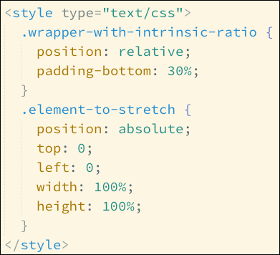
Using padding for an intrinsic ratio (cont)
Two elements needed
Often a <div> container and the player
The outer container uses padding-bottom with a percentage to control its size
The percentage determines the height of the element based on its parent's width
The inner element styled to fill the outer container
Demo: padbottom-show-concept.html

Slide 10
Using an intrinsic ratio with the Brightcove player

Slide 11
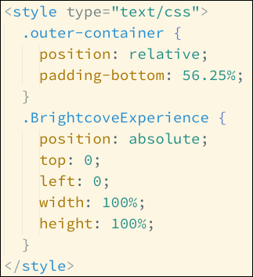
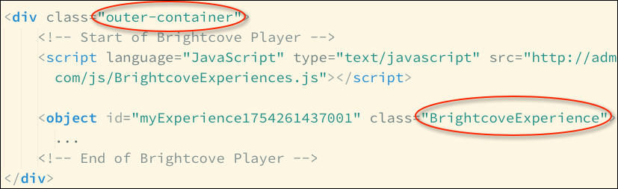
Using padding-bottom with a Brightcove player
Determine the percentage
For a 16:9 video want the height to be 9/16ths of the width
9/16 = .5625, and as a percentage 56.25%
Style appropriately
Demo: padbottom-solution.html

Slide 12
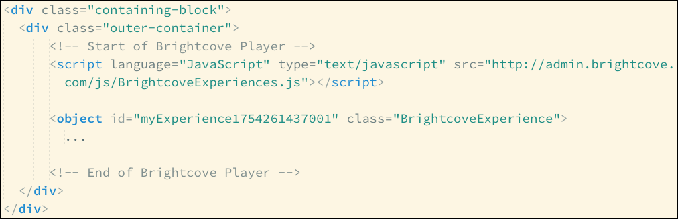
Control size of video
If full width video is not desired, add another bounding container
Demo: padbottom-solution-not-full-width.html

Slide 13
Intrinsic ratio works well with Twitter Bootstrap
Demo: bootstrap-demo.html
Demo: bootstrap-demo-with-grid.html

Slide 14
Calculating the intrinsic ratio for non-standard video sizes

Slide 15
Calculating ratio if videos not standard
Possible not all video 16:9, or any standard
In this case the percentage can be calculated based on playing rendition
Uses the Smart Player API
Demo: padbottom-soution-not169.html

Slide 16
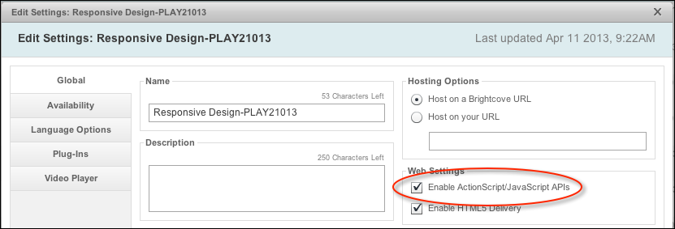
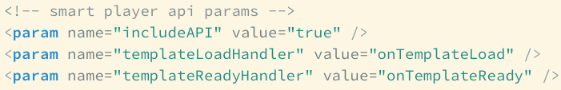
Prepare player and page for API use
Check the box so player enables API use
Add code to normal player
Demo: padbottom-ready-for-api.html

Slide 17
Calculating the intrinsic ratio
Get a reference to the player
Get a reference to the module that contains the methods needed for this functionality
Get the information for the currently playing rendition
Calculate the ratio
Apply ratio to the element
Demo: padbottom-calculate-solution.html

Slide 18

Using the Smart Player API: Resources
Get Started with the Smart Player API
http://docs.brightcove.com/en/smart-player-api/quick-start.html
Smart Player API Samples: Basic Setup
http://docs.brightcove.com/en/smart-player-api/samples/basic-setup.html
Webinar — Sign up from the Brightcove home page

Slide 19
Updating the video in the iFrame when in HTML Mode

Slide 20

Problem with HTML mode
In HTML mode the player container will resize, but the actual video does not
On resize only a portion of the video appears

Slide 21
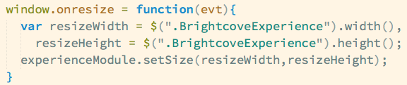
Resize the iFrame
In HTML mode the video plays in an iFrame
The video must be resized with the iFrame
Use the Experience Module's setSize() method in a JavaScript window.onresize event handler
The width and height can be retrieved from the iFrame's class name, which is BrightcoveExperience

Slide 22
Responsive Video.js players

Slide 23
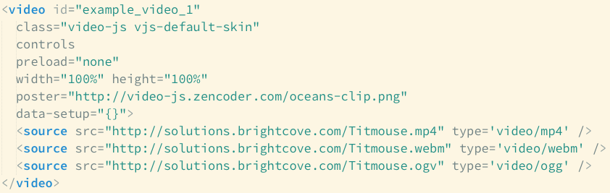
Understanding Video.js
Video.js was built as an HTML5 player from the ground up
Best free, open, HTML5 player in the market

Slide 24
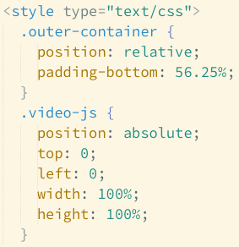
Intrinsic ratio works with Video.js
Very similar strategy as with Brightcove Experience player
Demo: videojs-solution.html

Slide 25
Calculating the intrinsic ratio: Video.js
Get a reference to the player
Add an event listener for the loadedmetadata event
Calculate the ratio using the videoHeight and videoWidth
Apply ratio to the element

Slide 26
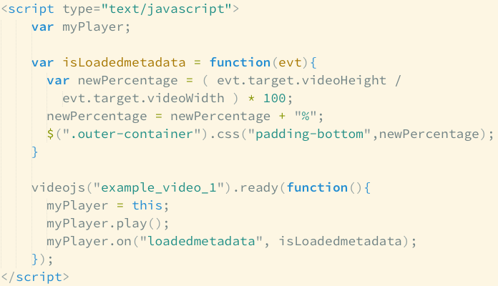
Calculating the ratio in Video.js
Same approach as Smart Player API, but using Video.js API

Slide 27
Calculating the ratio in Video.js (cont)
Demo: videojs-solution-calculate.html

Slide 28
Using the Video.js API: Resources
Video.js home page
http://videojs.com/
Video.js API docs
https://github.com/zencoder/video-js/blob/master/docs/api.md

Slide 29
Keep on your radar
Set width and height of the Video.js player to auto
Use viewport units to set width and height
With vw/vh, you can size elements to be relative to the size of the viewport
One vw/vh unit reflects 1/100th the width/height of the viewport
To make an element the full width of the viewport, for example, you'd set it to width:100vw

Slide 30
Thank you
CONTACT ME AT mboles@brightcove.COM
Please take a moment to complete a session evaluation.
Your feedback will help improve Brightcove PLAY.
Session Name: Responsive Players
Day/Time: Tuesday – 4:40
Presenter: Matt Boles

